Slide 1
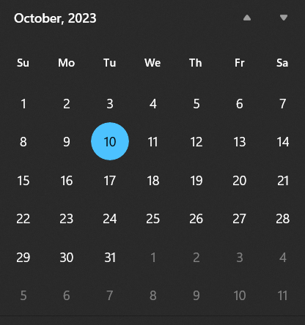
Week 8 (of 14)
I would like to have the mid-terms on week 8
Projects can be due after that, if you’d like.
Do you want a lecture when the exam is happening?
- Posted at 12:01 AM and due by 11:59 PM the same day. NO…?
Thursday 26th : Patterns (a classic game or something like that)
Friday 27th : Graphics
Monday 30th : Physics

